Slide 1

HTML

Slide 2
What is HTML?
HTML stands for Hyper Text Markup Language
A markup language is a set of markup tags
The tags describe document content
HTML documents contain HTML tags and plain text
HTML documents are also called web pages

Slide 3

Web Browsers
The purpose of a web browser (such as Google Chrome, Internet Explorer, Firefox, Safari) is to read HTML documents and display them as web pages.
The browser does not display the HTML tags, but uses the tags to determine how the content of the HTML page is to be presented/displayed to the user:

Slide 4
HTML Tags
HTML markup tags are usually called HTML tags:
HTML tags are keywords (tag names) surrounded by angle brackets like <html>
HTML tags normally come in pairs like <b> and </b>
The first tag in a pair is the start tag, the second tag is the end tag
The end tag is written like the start tag, with a forward slash before the tag name
Start and end tags are also called opening tags and closing tags
Example: <tagname>content</tagname>

Slide 5
Closing tags
The </body> and </html> put a close to their respective elements.
Not all tags have closing tags like this.
Some tags, which do not wrap around content, will close themselves. The line-break tag for example, looks like this : <br>
You might come across “self-closing” tags, whereby a br tag, for example, will look like <br /> instead of simply <br>.
This is a remnant of XHTML, a form of HTML based on another markup language called XML.
HTML5 will be happy with either format.
All tags with content should be closed, in the format of
opening tag → content → closing tag for good practice.

Slide 6
What are Attributes and Elements?
Attributes
Tags can also have attributes, which are extra bits of information.
Attributes appear inside the opening tag and their values sit inside quotation marks.
<tag attribute="value">Sample text</tag>
Elements
Tags mark the beginning and end of an element.
Elements are the bits that make up web pages.
While <title> and </title> are tags,
<title>Westworld</title> is a title element.
There is also the title attribute!

Slide 7
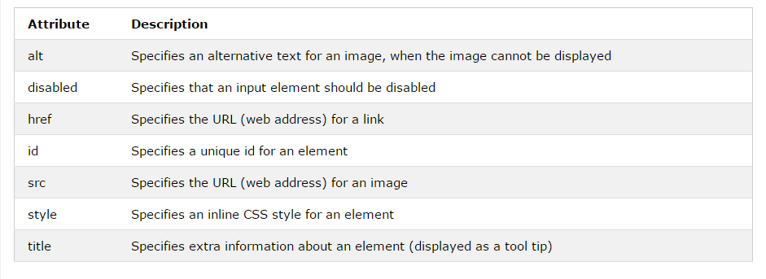
Examples of HTML Attributes
A more comprehensive list: https://developer.mozilla.org/en-US/docs/Web/HTML/Attributes.
<img src="w3schools.jpg" alt="W3Schools.com" width="104" height="142">
<a href="/studyatdit/" rel="nofollow" target="_blank">Study</a>

Slide 8
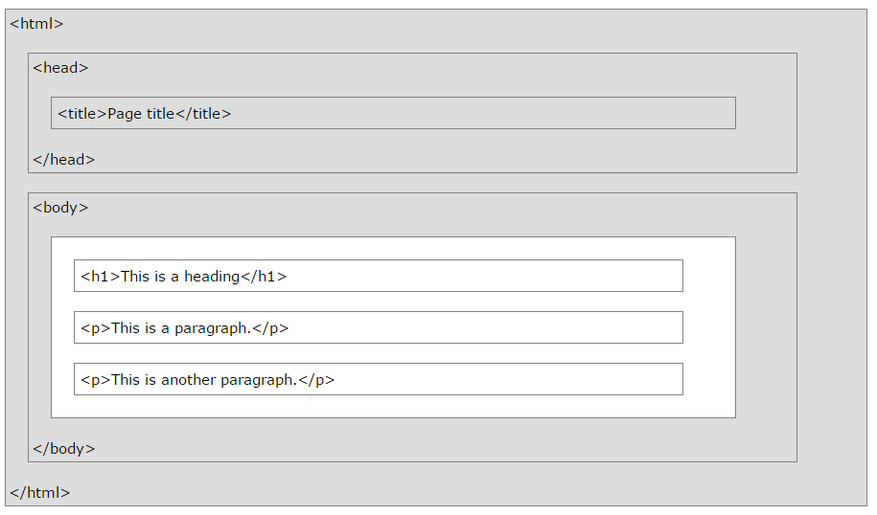
HTML Page Structure

Slide 9
HTML Versions
Version | Year
HTML | 1991
HTML 2.0 | 1995
HTML 3.2 | 1997
HTML 4.01 | 1999
XHTML | 2000
HTML5 | 2014

Slide 10
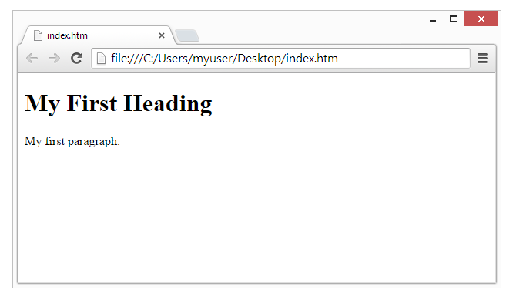
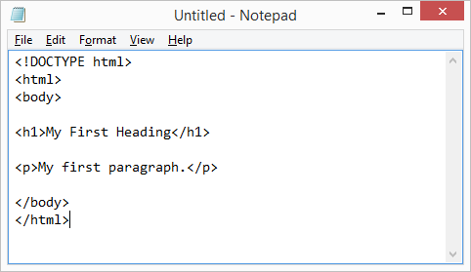
Editing HTML with Notepad++
Start Notepad++
Edit your file
Save as HTML
index.html
Double-click to open the HTML file in Your Browser

Slide 11
The <!DOCTYPE> Declaration
The <!DOCTYPE> declaration is the very first thing in your HTML document, before the <html> tag.
<!DOCTYPE> is not an HTML tag; it is an instruction to the browser about what version of HTML the page is written in.
HTML5
<!DOCTYPE html>

Slide 12
<head> and <body>
<head>
The head element (<head> </head>) appears before the body element and contains information about the page (i.e., metadata).
The information in the head element does not appear in the browser window.
<body>
Contains the document itself.
Notes:
Metadata such as the page title and page description, how to style the page or what stylesheets should be used to get that information, keywords, how often to refresh the page, and meta tags for sharing on Social Media pages.

Slide 13
<title>
The <title> tag must be placed inside the <head> element:
<!DOCTYPE html>
<html>
<head>
<title>My first web page</title>
</head>
<body>
This is my first web page
</body>
</html>
If you look at this document in the browser, you will see that “My first web page” will appear on a tab or the title bar of the window .
If you add this page to your “favourites” (or “bookmarks”), you’ll see that the title is also used there.
Notes:
Also used by Search Engines – but the page title can be different in the search results

Slide 14
HTML Headings
Headings are defined with the <h1> to <h6> tags.
<h1> defines the most important heading; <h6> defines the least important heading.
Don't use headings to make text BIG or bold.
Search engines use your headings to index the structure and content of your web pages.
Since users may skim your pages by its headings, it is important to use headings to show the document structure.

Slide 15
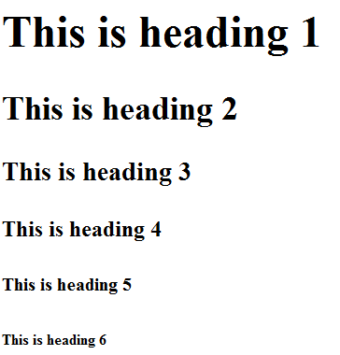
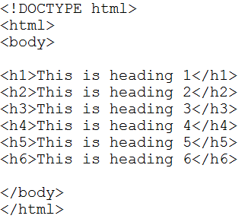
HTML Headings

Slide 16
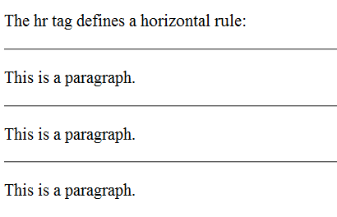
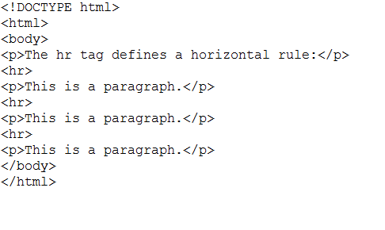
HTML Lines
The <hr> tag creates a horizontal line in an HTML page.
The hr element can be used to separate content:

Slide 17
HTML Comments
Comments can be inserted into the HTML code to make it more readable and understandable.
Comments are ignored by the browser and are not displayed. However, they will be shown in the source code of your pages which can be viewed by all users of your website.
Comments are written like this:
<!-- This is a comment -->

Slide 18
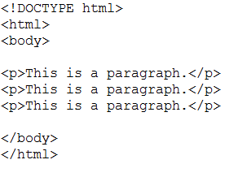
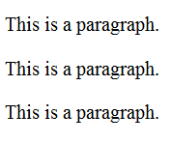
HTML Paragraphs
HTML documents are divided into paragraphs.
Paragraphs are defined with the <p> tag:

Slide 19
HTML Hyperlinks
The HTML <a> tag defines a hyperlink.
A hyperlink (or link) is a word, group of words, or image that you can click on to jump to another document.
The most important attribute of the <a> element is the href attribute, which indicates the link's destination.
Syntax:
<a href="http://www.dit.ie/"> Visit DIT </a>

Slide 20
HTML Hyperlinks
The URL can be any of the following:
An absolute URL. Don’t forget the protocols (e.g., http://, https://, ftp://, mailto:, file:).
A relative URL. Points to other files within the same website (e.g., href="images.html", href="music/listings.html", href="../../index.html").
A link to a specific part of the same page. Requires the use of the element’s id attribute (e.g., href="#top" to reference to <h2 id="top">This is the top of the page</h2>).
A script E.g., href="javascript:alert('Hello');".
The target attribute specifies where to open the linked document. The example below will open the linked document in a new browser window or a new tab:
<a href="http://www.dit.ie/" target="_blank"> Open DIT in a new tab </a>
Notes:
Target: _blank, _self, _parent, _top, framename

Slide 21
HTML Images
In HTML, images are defined with the <img> tag.
The <img> tag is empty, which means that it contains attributes only, and has no closing tag.
To display an image on a page, you need to use the src attribute. Src stands for "source".
The value of the src attribute is the URL of the image you want to display.
<img src="url" alt="some_text">
The alt attribute specifies an alternative text to be used, when an image cannot be displayed.
Size attributes (in pixels, by default):
<img src="w3schools.jpg" width="104" height="142">
Notes:
Img size in pixels

Slide 22

HTML Tables
Tables are defined with the <table> tag.
A table is divided into rows (with the <tr> tag), and each row is divided into data cells (with the <td> tag).
td stands for "table data," and holds the content of a data cell.
A <td> tag can contain text, links, images, lists, forms, other tables, etc.
<table border="1"> <tr> <td>row 1, cell 1</td> <td>row 1, cell 2</td> </tr> <tr> <td>row 2, cell 1</td> <td>row 2, cell 2</td> </tr> </table>

Slide 23
HTML Lists
Unordered Lists
An unordered list starts with the <ul> tag. Each list item starts with the <li> tag.
The list items will be marked with bullets (i.e., ) by default.
<ul> <li>Coffee</li> <li>Milk</li> </ul>
Ordered Lists
An ordered list starts with the <ol> tag. Each list item starts with the <li> tag.
The list items are marked with numbers.
<ol> <li>Coffee</li> <li>Milk</li> </ol>
Coffee
Milk
Coffee
Milk
Notes:
The CSS list-style-type property can be used to style the bullet points (e.g., none – no bullet, disc , circle ○, square ).

Slide 24
Description Lists
A description list is a list of terms/names, with a description of each term/name.
The <dl> tag defines a description list.
The <dl> tag is used in conjunction with <dt> (defines terms/names) and <dd> (describes each term/name):
<dl> <dt>Coffee</dt> <dd>- black hot drink</dd> <dt>Milk</dt> <dd>- white cold drink</dd> </dl>
Coffee
- black hot drink
Milk
- white cold drink

Slide 25
Tips:
Lower-case tags and attributes.
Quotes “” in attribute values.
To see the HTML code of a page, right-click in the page and select "View Page Source" (in Chrome) or similar in another browser.
With HTML, you cannot change the output by adding extra spaces or extra lines in your HTML code.
The browser will remove any extra spaces and extra lines when the page is displayed.

